Slide 1

Jake Hutton Primary Project
Email Analysis Tool
www.autobound.ai

Slide 2
Agenda
Project Objective Recap
Data Collection Process Review
Email Analysis Tool Overview
Model Training Results
Email Analysis Tool Demo
Autobound, Inc. sales@autobound.ai
2

Slide 3
Project Objective
To recap, the objective of my primary project was to create a tool to help generate insights from email body and subject line text
The tool was to include entity extraction and sentiment analysis, keyword extraction was also added
Tool created using Python Jupyter Notebook
Autobound, Inc. sales@autobound.ai
3

Slide 4
Data Collection Process Review
Data was retrieved from two sources:
Autobound Internal Dataset
The internal dataset consisted of around 4,000 email messages. These were used build out the framework of the Email Analysis Tool while external data was being collected
Externally Generated Data
SQR’s were sent using a fictitious email account in order to generate context specific email examples. Dataset was used to generate annotated training data from NER model training.
Autobound, Inc. sales@autobound.ai
4

Slide 5
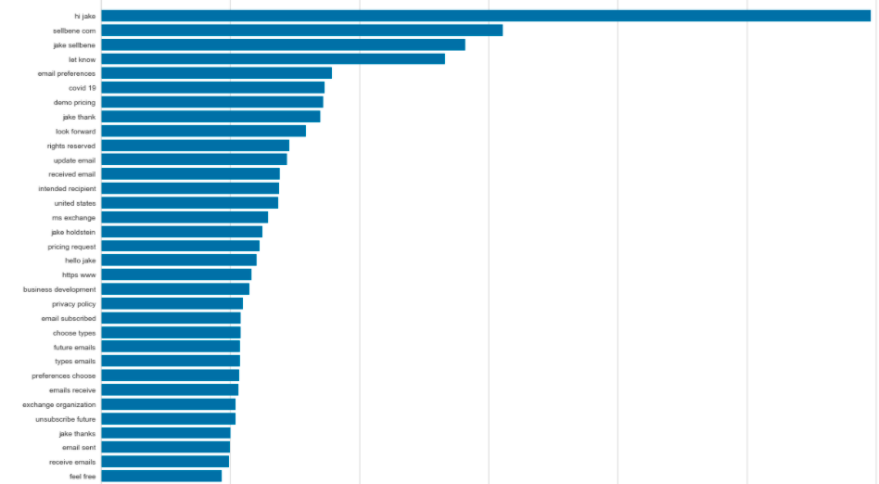
Feature Generation
Additional Features were identified through data exploration as bring exceedingly common
These terms were included in NER training to identify “stale” of “overused” features that could potentially make an email sound “spammy”
“covid 19”
“looking forward”
These three features stood out above the noise as having event relevance (COVID 19), as well as, ”stale” or “overused” words (“looking forward”, ”feel free”)
“feel free”
Autobound, Inc. sales@autobound.ai
5

Slide 6
Email Analysis Tool Overview
The Email Analysis Tool combines three main functionalities into one Jupyter Notebook
Keyword Extraction
Sentiment Analysis
Jake’s Tool
Named Entity Recognition
Autobound, Inc. sales@autobound.ai
6

Slide 7
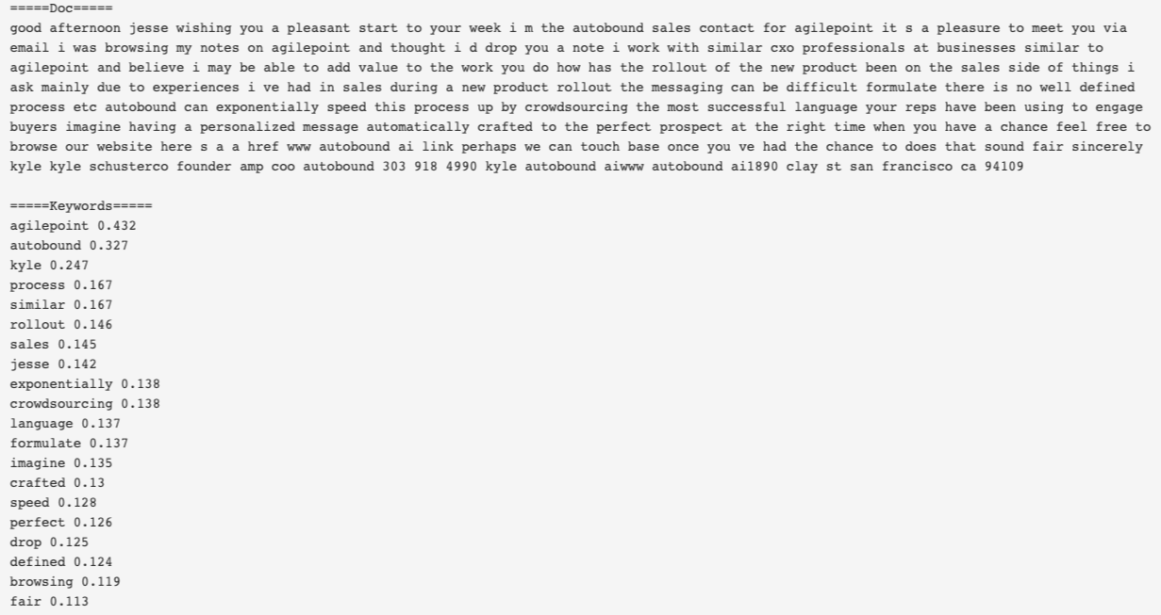
Email Analysis Tool Overview
Keyword Extraction-Example
Keyword Extraction uses TF-IDF which is a measure of word originality within a document
This enables the extraction of “important” words within the context of the document
In the example the words are ordered in descending order with the most important words at the top
For a more detailed breakdown please visit: https://jakes-primary-project.atlassian.net/wiki/spaces/JPP/pages/55214083/Keyword+Extractor+Tool
Autobound, Inc. sales@autobound.ai
7

Slide 8
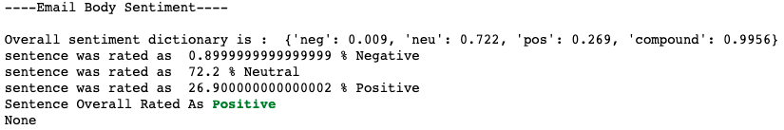
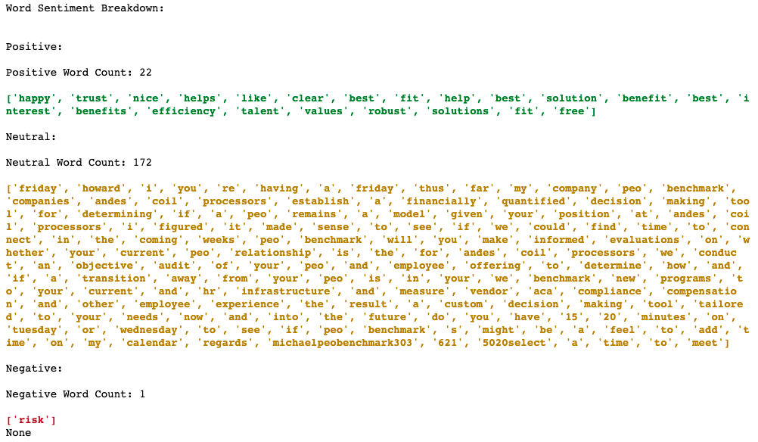
Email Analysis Tool Overview
Sentiment Analysis-Example
The Sentiment Analysis functionality of the tool scores the sentiment of the entire document, as well as, prints the words within the document identified as positive, neutral, or negative
Results will also provide a word count for each sentiment class and a sentiment breakdown by each sentence of an email
For a more detailed breakdown please visit: https://jakes-primary-project.atlassian.net/wiki/spaces/JPP/pages/65962184/Sentiment+Analysis+Tool
Autobound, Inc. sales@autobound.ai
8

Slide 9
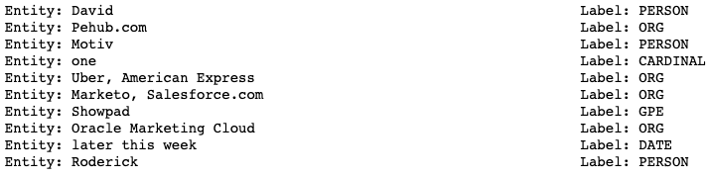
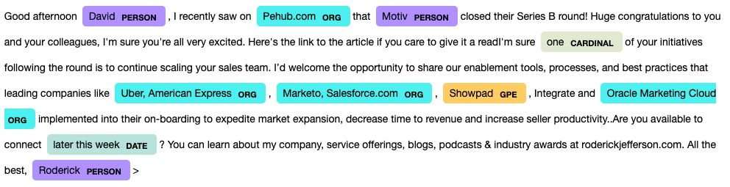
Email Analysis Tool Overview
Named Entity Recognition-Example
NER model identifies entity classes in the email text and lists out the entity and its label
The tool also super imposes the entities labels by color on the text for visualization
SpaCy offered a base NER model to work off of
This base model was used to improve/train new entity classes using the external dataset
For a more detailed breakdown please visit: https://jakes-primary-project.atlassian.net/wiki/spaces/JPP/pages/65863681/Entity+Extraction+Model+using+SpaCy
Autobound, Inc. sales@autobound.ai
9

Slide 10
Email Analysis Tool Overview
Trained NER Model Entity Classes
PERSON
DATE
GPE
TITLE
TIME
PHONE
EMAIL
URL
EVENT
ORG
QUESTION
MONEY
PERCENT
CARDINAL
ORDINAL
LOOKING_FORWARD_TO
I_HOPE
ID_LOVE
FEEL_FREE
FOLLOW_UP
I_WANTED
EMOJI
Autobound, Inc. sales@autobound.ai
10

Slide 11
Email Analysis Tool Overview
Email Analysis Tool
To get a better understanding and sense of functionality of the Email Analysis Tool please visit: https://jakes-primary-project.atlassian.net/wiki/spaces/JPP/pages/69697542/Autobound+Email+Analysis+Tool
This link provides an example of the tool in use, provides instructions for use, and contains a zip file with both the Juyter notebook, most current NER model, and csv file for hands-on use
Autobound, Inc. sales@autobound.ai
11

Slide 12
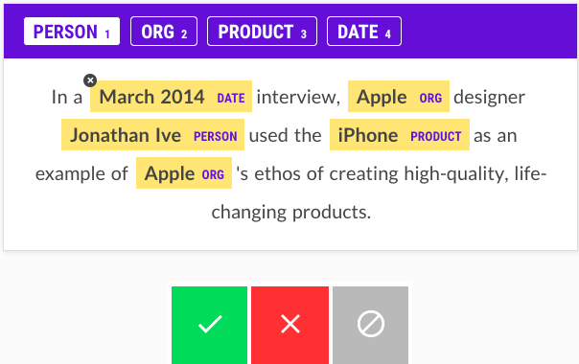
Model Training
Model training was conducted to both train new entity classes, as well as, improve model accuracy with context specific examples.
The Prodigy annotation tool was used to create a training dataset that is used to train/improve the SpaCY NER model
Prodigy was created by the makers of SpaCy which made for smooth integration
12
Autobound, Inc. sales@autobound.ai

Slide 13
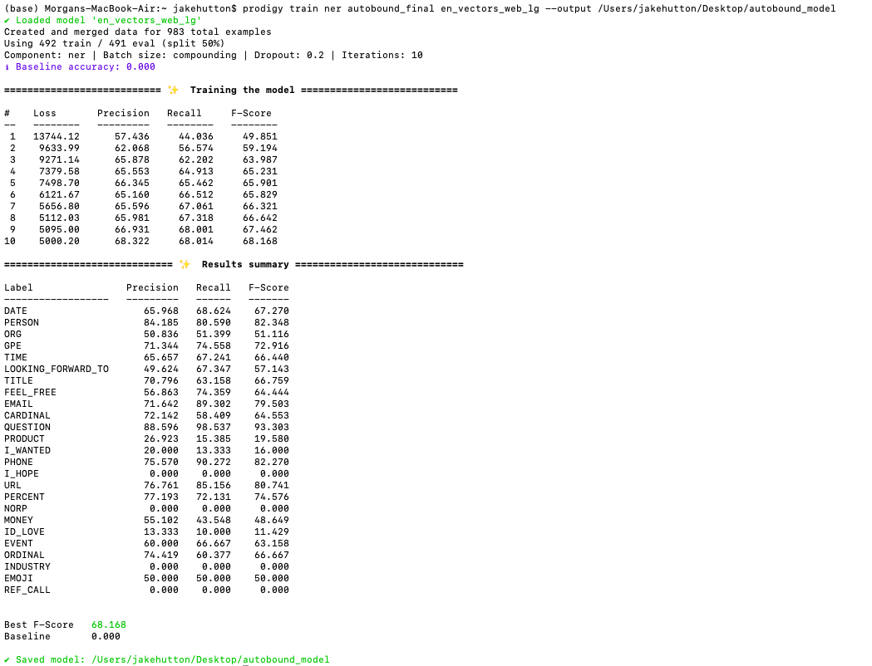
Model Training
The first dataset contained annotations on approximately 938 email messages from the external dataset
Prodigy splits the dataset of annotations to evaluate performance
The model runs through 10 iterations producing a precision, recall, and F1 score
The iteration with the highest F-score results is saved as the updated model
We can also see how the individual entities performed for fine tuning moving forward
13
Autobound, Inc. sales@autobound.ai
Notes:
Precision is defined as the ratio between all the instances that were correctly classified in the positive class against the total number of instances classified in the positive class. In other words, it's the percentage of the instances classified in the positive class that is actually right.
Recall is defined as the ratio between all the instances that were correctly classified in the positive class against the total number of actual members of the positive class. In other words, it tells you how many of the total numbers of positive instances were correctly classified.

Slide 14
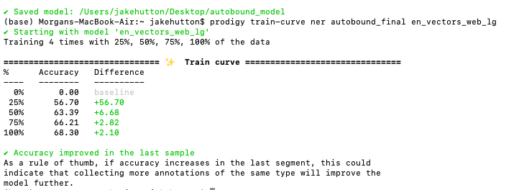
Model Training
After training is complete, I ran the “train-curve” prodigy recipe on the dataset as a diagnostic
This runs through the dataset 4 separate time, using 25%, 50%, 75%, and 100% of the data each time
The train-curve recipe is trying to simulate the effect of increasing the amount of training data
If we see an accuracy increase from 75% to 100% then it’s a good indication that adding more training data of the similar type will increase model accuracy
14
Autobound, Inc. sales@autobound.ai
Notes:
Precision is defined as the ratio between all the instances that were correctly classified in the positive class against the total number of instances classified in the positive class. In other words, it's the percentage of the instances classified in the positive class that is actually right.
Recall is defined as the ratio between all the instances that were correctly classified in the positive class against the total number of actual members of the positive class. In other words, it tells you how many of the total numbers of positive instances were correctly classified.

Slide 15
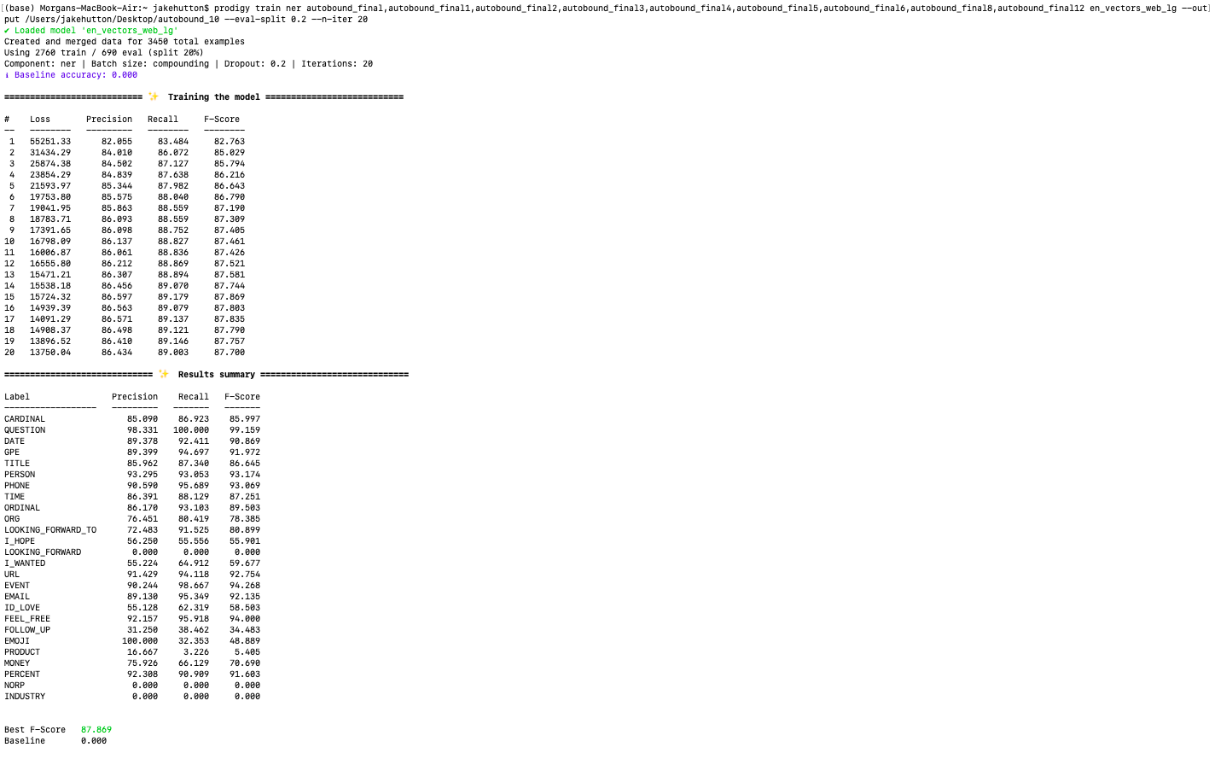
Model Training
Process was repeated 9 more times, incrementally increasing the amount of training data
Final model contained 3,450 annotated emails with an overall model F1 Score of 87.869
15
Autobound, Inc. sales@autobound.ai
Notes:
Precision is defined as the ratio between all the instances that were correctly classified in the positive class against the total number of instances classified in the positive class. In other words, it's the percentage of the instances classified in the positive class that is actually right.
Recall is defined as the ratio between all the instances that were correctly classified in the positive class against the total number of actual members of the positive class. In other words, it tells you how many of the total numbers of positive instances were correctly classified.

